Slide 1
Operating Systems and Architectures CSCM98, Part 6: Memory Management
Dr. Benjamin Mora
1
Swansea University
Benjamin Mora

Slide 2
Content
Objectives & Issues.
Memory Space.
Memory Partitioning Techniques.
Physical & Virtual Address Space.
Virtual Memory Implementation.
Algorithms for page replacement.
Shared Memory/Shared Libraries
Caches
2
Swansea University
Benjamin Mora
Notes:
Possibly quickly discuss event programming and multi-processor as well
64-bit systems

Slide 3
Objectives & Issues
3
Swansea University
Benjamin Mora

Slide 4
Physical Memory Hierarchy
CPU Registers
L1 Caches (TLB, instructions & data)
Size,
Latency
L2 Cache
Cost,
Speed,
Transparent to OS
L3 Cache
RAM
(Primary Storage)
OS awareness
Hard Drive
(Secondary Storage)
Cloud Storage
4
Swansea University
Benjamin Mora

Slide 5
Type of OS/Memory Environments
5
Swansea University
Benjamin Mora
Notes:
Add that there is not a single type of OS, but a wide variety of them.

Slide 6
Memory Requirements for a process: Standard Virtual Memory Environment
Process Control Block
Program
Virtual Address
Heap
Top of Stack
Stack
6
Swansea University
Benjamin Mora
Notes:
Process image for a common OS (e.g., Windows, Linux, Mac OS)

Slide 7
Memory Management: OS Objectives
To keep track of which parts of the memory are in use and which parts are not.
To allocate memory to processes when they need it and to de-allocate it when not required anymore.
To move process code & data between storage layers when the closer layer is not big enough to hold all processes (e.g., RAM to Disk).
To give the illusion that there is more memory available than what is actually physically available.
7
Swansea University
Benjamin Mora
Notes:
Caches not concerned by point 3!

Slide 8
Memory Management: Objectives
Each process will have its own (virtual) address space.
Two virtual addresses (e.g., address of a stored integer) of two processes can be the same, but will be located at different physical addresses.
A virtual to physical address translation must be implemented…
In Hardware.
MMU+TLB.
8
Swansea University
Benjamin Mora

Slide 9
Memory Management Requirements
5 requirements (according to Lister and Eager) for memory management:
Protection.
Sharing.
Relocation.
Logical Organization.
Physical Organization.
9
Swansea University
Benjamin Mora

Slide 10
Memory Protection
No (regular) processes shall access the memory content of other processes
Process would become corrupted.
Safety and Security (e.g., Viruses).
What about shared libraries?
Not possible at compilation time
Dynamic parameters cannot be considered (size of an image).
CPU support/acceleration for run-time checks
Paging.
Non-Executable bit.
Memory allocation status.
…
10
Swansea University
Benjamin Mora

Slide 11
Sharing
Protection does not allow sharing memory.
A mechanism to support shared memory is needed
Virtual Memory and Pages.
MMU.
Inserting a page into another’s page table.
What about Distributed Systems?
Possible, but latency is a problem!
11
Swansea University
Benjamin Mora

Slide 12
Relocation
Process location can possibly be changed by the OS
Processes can be swapped in and out.
The programmer and the compiler do not usually know:
where the program/process data will be physically located
need a specific mechanism.
what are the other processes and threads running in parallel?
Including threads generated by the program being compiled.
12
Swansea University
Benjamin Mora
Notes:
Exception to point 2: Safety critical systems

Slide 13
Organization
Logical Organization:
Linear indexing of memory.
Program modules.
Physical Organization:
Memory indexing/Memory broken down into small blocks.
Flow of data between main memory and secondary memory.
13
Swansea University
Benjamin Mora

Slide 14
Memory Partitioning Techniques
14
Swansea University
Benjamin Mora

Slide 15
Memory Partitioning Techniques
Fixed Partitioning.
Dynamic Partitioning.
Paging.
Segmentation.
Memory Allocation: Buddy algorithm
Virtual Memory.
15
Swansea University
Benjamin Mora

Slide 16
Fixed Partitioning
Memory divided into partitions when the OS is started.
Partitions can be equal or unequal.
A process per partition
Very Simple.
Some issues when
program is larger than the partition.
Loss of memory space
Internal Fragmentation.
Relatively straightforward and safe
E.g., Aircraft System
RAM/Memory
1 MB
2 MB
2 MB
4 MB
16
Swansea University
Benjamin Mora

Slide 17
Dynamic Partitioning
Partitions created dynamically.
Efficient use of memory.
Complex to maintain. Requires extra operations
to reduce external fragmentation
Compaction possible, although not so efficient.
Requires shifting of memory data (relocating).
RAM/Memory
Process A
Process B
Process C
Process D
17
Swansea University
Benjamin Mora

Slide 18
Dynamic Partitioning
Partitions created dynamically.
Efficient use of memory.
Complex to maintain. Requires extra operations
to reduce external fragmentation
Compaction possible, although not so efficient.
Requires shifting of memory data (relocating).
RAM/Memory
Process B
Process D
18
Swansea University
Benjamin Mora

Slide 19
Dynamic Partitioning : Placement
Compaction not always required.
Placement Algorithm.
Memory
First Fit
Best Fit
Empty area
Worst Fit
Non Empty area
Process to Add
Next Fit
19
Swansea University
Benjamin Mora

Slide 20
Memory Allocation
Processes need memory to be allocated and de-allocated dynamically
E.g.: User opens an image.
Size is unknown at compilation time and cannot been known in advance.
An efficient algorithm that keeps track of memory allocation must be implemented
Separate issue from paging!
Also needed in file systems.
Done during calls to new and delete (C++) operators, malloc and free (C), etc...
20
Swansea University
Benjamin Mora

Slide 21
Memory Allocation
Using (linked) lists for tracking allocation?
Memory
0
A.0
A
8
B
A, Size: 07 bytes, @0
16
B, Size: 04 bytes, @8
C
C, Size: 16 bytes, @16
D, Size: 40 bytes, @56
56
D
Swansea University
21
Swansea University
Benjamin Mora

Slide 22
Memory Allocation
Issues with lists of occupied blocks
Difficult to find a new free block
Better to track free blocks.
Linear complexity in introducing & removing elements.
Other options
Bitmaps (see file systems)
0 or 1 to describe the state of a block.
22
Swansea University
Benjamin Mora

Slide 23
Memory Allocation : Buddy algorithm
Performance?
Allocation/De-allocation performance
How fast is it to find a free block?
Space usage.
Buddy algorithm is used in various places including Unix/linux
Works with lists of power of two sizes.
Has a min/max memory block allocation (e.g., 64 bytes to 4 GBs).
23
Swansea University
Benjamin Mora

Slide 24
Memory Allocation : Buddy algorithm
Buddy algorithm
Fast at best fit allocation.
Fast compaction.
Minimizes external fragmentation.
But produces internal fragmentation when requested size is not a power of two.
24
Swansea University
Benjamin Mora

Slide 25
Buddy algorithm : Example
Starting state
1 Full block of 128K
2K minimum frames
Memory Address
List 128K
128K
List 64K
List 32K
List 16K
List 8K
List 4K
List 2K
25
Swansea University
Benjamin Mora

Slide 26
Buddy algorithm : Example
Starting state
1 request for 3 KBs
Memory Address
List 128K
128K
List 64K
List 32K
List 16K
List 8K
List 4K
List 2K
26
Swansea University
Benjamin Mora

Slide 27
Buddy algorithm : Example
Starting state
1 request for 3 KBs
Memory Address
List 128K
List 64K
64K
64K
List 32K
List 16K
List 8K
List 4K
List 2K
27
Swansea University
Benjamin Mora

Slide 28
Buddy algorithm : Example
Starting state
1 request for 3 KBs
Memory Address
List 128K
List 64K
64K
List 32K
32K
32K
List 16K
List 8K
List 4K
List 2K
28
Swansea University
Benjamin Mora

Slide 29
Buddy algorithm : Example
Starting state
1 request for 3 KBs
Final stage
Memory Address
List 128K
List 64K
64K
List 32K
32K
List 16K
16K
List 8K
8K
List 4K
4K
4K
List 2K
Allocated block
29
Swansea University
Benjamin Mora

Slide 30
Memory Allocation : Buddy algorithm
Buddy algorithm
When allocating n bytes, the algorithm first looks for the closest non-empty list such that n<=2 ^{BlockSize(list)}.
If block size is >= 2n then block is subdivided into 2 sub blocks of equal sizes, with one of them appended to the next list.
And so on recursively until a satisfying block size respecting the criterion is found.
If a list cannot be found, then allocation is not possible.
30
Swansea University
Benjamin Mora

Slide 31
Physical & Virtual Address Space
31
Swansea University
Benjamin Mora

Slide 32
Paging
Processes and Memory are partitioned into chunks.
Pages for processes.
Frames for memory.
Both have the same size.
Memory
0
A.0
C.0
1
A.1
C.1
2
B.0
3
B.1
4
B.2
5
C.2
6
C.3
Process B
Page Table
Process C
Page Table
0
2
0
0
1
3
1
1
2
4
2
5
3
3
6
32
Swansea University
Benjamin Mora

Slide 33
Segmentation
Similar to paging
Descriptor table.
Logical VS Physical addressing.
Segments can have different sizes.
One addition register needed:
Stores the base address.
Regular memory address is the offset.
Multi-segment approach to separate programs, stacks and data.
Hardware Support on x86.
33
Swansea University
Benjamin Mora

Slide 34
Segmentation
Physical
Memory
Memory
Segment (base)
0
Logical
Address
1
Offset
2
3
Segment
4
0
5
1
6
2
7
3
…
4
…
Swansea University
34
Swansea University
Benjamin Mora

Slide 35
Virtual Memory
Useful for addressing more memory than physically available.
Each process uses his own virtual address space.
Protection.
Indexing isn’t cheap!
Hardware Support (MMU, TLB).
Done for every mov instruction.
35
Swansea University
Benjamin Mora

Slide 36
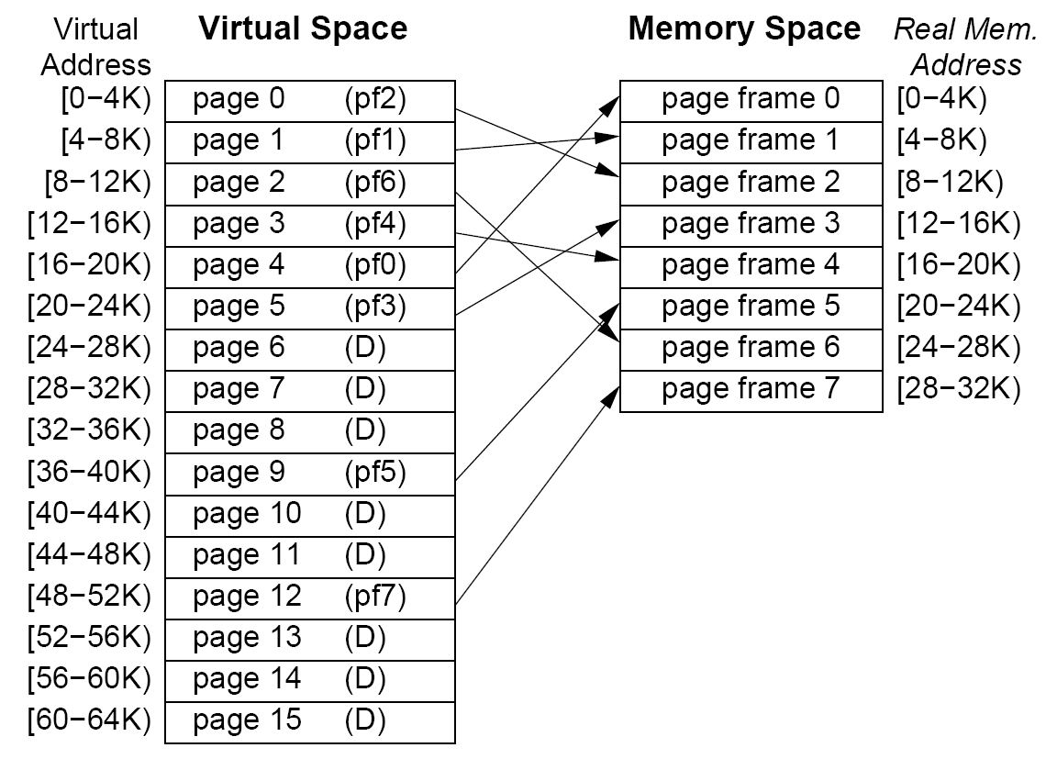
Paging
36
Swansea University
Benjamin Mora

Slide 37
Paging Implementation
Accessing the page table is required for any memory access.
Double the amount of memory accesses.
Fetching the next instruction.
The Memory Management Unit (MMU) takes care of it.
Quite specific to the processor.
Translation Lookaside Buffer (TLB)
Another Cache
37
Swansea University
Benjamin Mora

Slide 38
Paging Implementation : MMU
Let’s suppose that we have:
4K frames.
32 bit addressing.
Virtual Page Number
Offset
00000000000000001010
001001001001
Address requested by instruction
Page Table
0
20 bit physical address
properties
1010
00000000000001001101
011001
00000000000001001101 001001001001
Physical Address
2²⁰-1
38
Swansea University
Benjamin Mora

Slide 39
Paging Implementation : MMU
Let’s consider a Monolithic 4 MBytes Page Table.
32 bits per element (20 bits + 12 property bits).
Plenty of transistors needed for storing the table.
Huge Bandwidth required when switching context.
What would be its size on a 64-bit system?
Therefore, some refinements are needed!
Table usually stored in (virtual) memory, not on the CPU.
The CPU’s TLB will cache a limited number of pages.
The Operating System must both manage and ensure the validity of the page table.
39
Swansea University
Benjamin Mora

Slide 40
2-level tree
to be written
Bruce Jacob & Trevor Mudge
Virtual Memory: Issues of Implementation
40
Swansea University
Benjamin Mora
Notes:
Discuss Hyper-threading

Slide 41
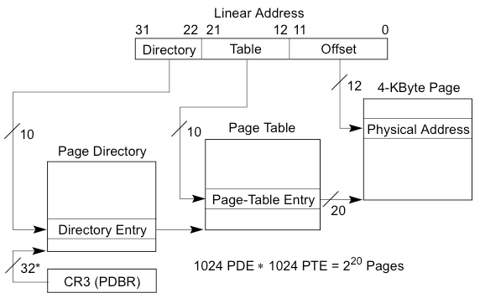
Paging Implementation : MMU
41
Swansea University
Benjamin Mora

Slide 42
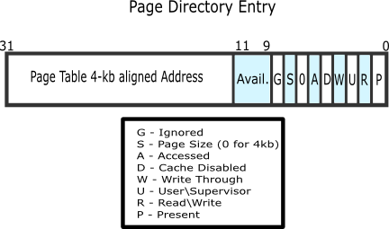
Example: Page Directory Entry
From http://wiki.osdev.org/Paging
42
Swansea University
Benjamin Mora

Slide 43
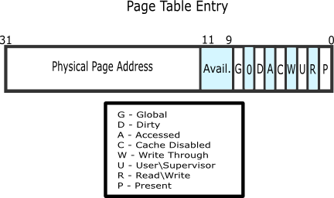
Example: Page Table Entry
From http://wiki.osdev.org/Paging
43
Swansea University
Benjamin Mora

Slide 44
Hardware Implementation Issues
One size doesn’t fit all.
Address translation wants coarse granularity, fixed-size regions.
Permissions want byte- (or, at least word-) granularity variable-size regions.
Permissions and translations change at different times.
44
Swansea University
Benjamin Mora

Slide 45
Translation Lookaside Buffer (TLB)
Simple page cache.
Allows real-time logical to physical address translation!
A few entries.
Usually 16 to 512 entries.
Several levels of cache possible
Page Number
00000000000000001010
00000000001001001010
TLB Cache
Virtual upper address
Real upper address
Row 1010
00000000001001001010
00000001000100001010
45
Swansea University
Benjamin Mora

Slide 46
Translation Lookaside Buffer (TLB)
What is happening when a page is not present in the TLB?
Table is read by CPU from memory and cache is (automatically) updated.
This hardware acceleration can be disabled.
Decrease in System Performance.
Several levels of TLBs can co-exist.
Different from a page fault:
Page is not present in main memory, or has not been created yet.
Very costly.
46
Swansea University
Benjamin Mora

Slide 47
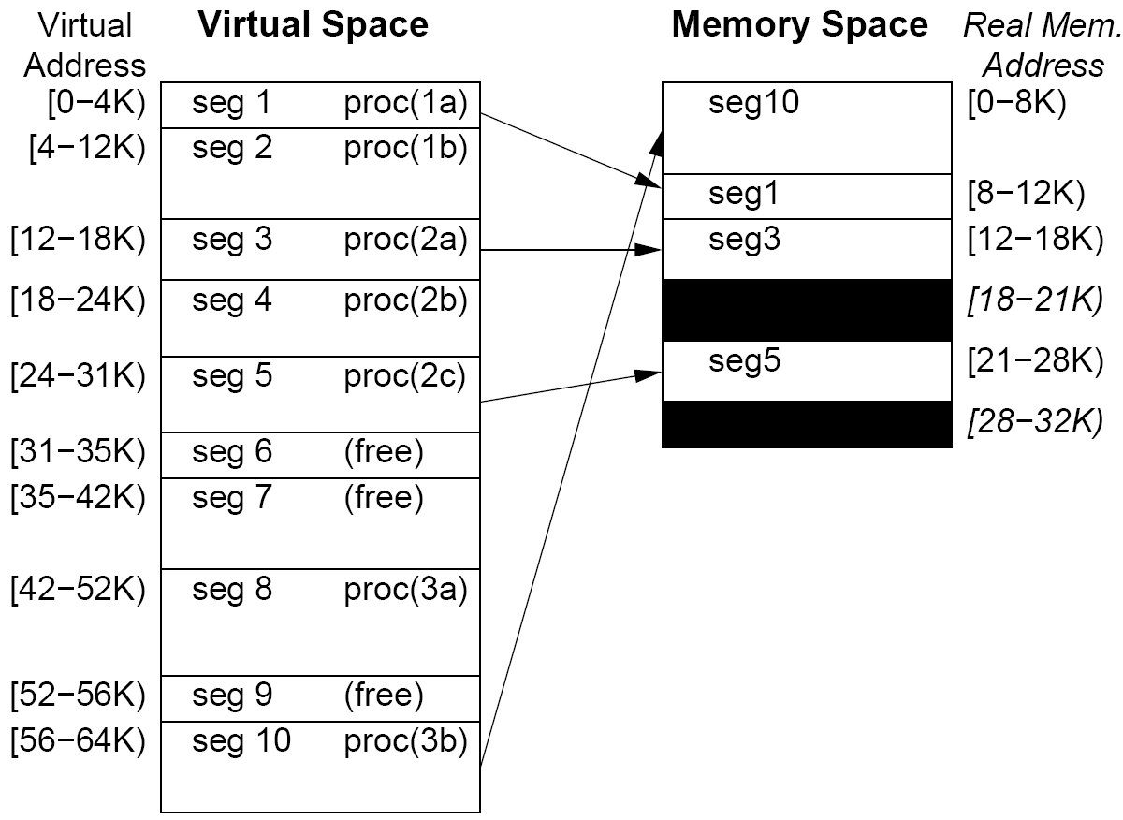
Segmentation
47
Swansea University
Benjamin Mora

Slide 48
Issues
Pure Segmentation difficult to implement in Hardware
Search difficult.
Not so much used anymore.
Combined Paging and Segmentation approach
Segments decomposed into fixed-size pages.
Supported by current hardware.
Pure Segmentation still supported
Compatibility.
48
Swansea University
Benjamin Mora

Slide 49
Segmentation on a Pentium Processor
49
Swansea University
Benjamin Mora

Slide 50
Virtual Memory and Algorithms for page replacement
50
Swansea University
Benjamin Mora

Slide 51
Algorithms for page replacement
The OS is (usually) called when a page fault occurs
Page stored on disk, not in RAM.
If the page is not stored in physical memory, it needs to be fetched from disk
A page must be swapped out of memory!
6 Algorithms
First In, First Out.
Optimal Algorithm.
Least Recently Used, Non Recently Used.
Clock Algorithms.
Stack Algorithms.
51
Swansea University
Benjamin Mora

Slide 52
First In, First Out (FIFO)
The page to be swapped out of memory will be the oldest one.
Easy to implement.
Quick to Execute.
Not so Efficient
Belady’s Anomaly
Increasing the number of pages not always best.
52
Swansea University
Benjamin Mora

Slide 53
Optimal Algorithm
Page selection criteria:
Longest time to next reference.
Best algorithm in terms of page fault reduction.
We however cannot predict the future!
Algorithm used as a reference for comparisons.
53
Swansea University
Benjamin Mora

Slide 54
Optimal Algorithm Example
3 Frames.
A frame is the physical memory space needed for a page.
Page access order: 0 1 2 3 0 1 4 0 1 2 3 4
0 1 2 3 0 1 4 0 1 2 3 4
0
0
0
0
0
0
0
0
0
2
2
2
1
1
1
1
1
1
1
1
1
3
3
2
3
3
3
4
4
4
4
4
4
x
x
x
x
x
x
x
54
Swansea University
Benjamin Mora

Slide 55
Belady’s Anomaly with FIFO alg.
Page access order: 0 1 2 3 0 1 4 0 1 2 3 4
3 or 4 frames.
5 pages
55
Swansea University
Benjamin Mora

Slide 56
Least Recently Used Algorithm (LRU)
Issue: Finding the least recently used page is a complex operation.
Needs to scan the last n elements.
LRU approximation.
nxn bit matrice.
56
Swansea University
Benjamin Mora

Slide 57
Least Recently Used Algorithm (LRU)
The least recently used page is swapped out of memory.
Efficient algorithm in theory.
0 1 2 3 0 1 4 0 1 2 3 4
0
0
0
3
3
3
4
4
4
2
2
2
1
1
1
0
0
0
0
0
0
3
3
2
2
2
1
1
1
1
1
1
4
x
x
x
x
x
x
x
x
x
x
57
Swansea University
Benjamin Mora

Slide 58
Least Recently Used Algorithm (LRU)
Sequence: 0 1 2
58
Swansea University
Benjamin Mora

Slide 59
Clock Algorithm With Reference Bit
59
Swansea University
Benjamin Mora

Slide 60
Clock Algorithm With NRU Strategy
2 bits required:
Referenced Bit (R).
Modified Bit (M).
Rules:
R & M initially set to 0.
When a page is referenced, its R bit is set to 1.
When a page is modified, its R and M bits are set to 1.
Periodic initialization of R.
60
Swansea University
Benjamin Mora

Slide 61
Two Handed Clock
61
Swansea University
Benjamin Mora

Slide 62
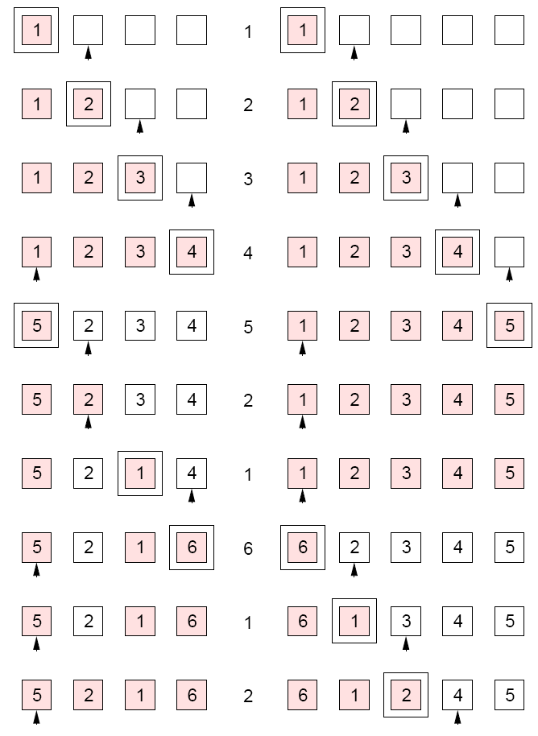
Stack Algorithms
Any algorithm where the set of pages for n frames would be a subset of the set of pages for n+1 frames.
Does not suffer from Belady’s algorithm.
62
Swansea University
Benjamin Mora

Slide 63
Shared Memory & Shared Libraries
63
Swansea University
Benjamin Mora

Slide 64
What is Shared Memory?
Sharing data between processes can be as simple as reading and writing a variable in code (Pointer or not) on shared memory systems.
e.g., int *mySharedInt; …
(*mySharedInt)++; //Example not safe at all without protections in place!!!
Usually reserved to systems that share the same RAM.
Processes managed on the same OS
As opposed to what was said before! (See next slide).
Dual Socket PCs.
SGI ALTIX
64
Swansea University
Benjamin Mora

Slide 65
Why Shared Memory?
Relatively fast for communication and synchronization.
No System Calls.
E.g. Dekker’s algorithm.
Easy MMU implementation.
Saves memory as some library code can be loaded once and shared among processes.
Graphics & sound drivers, etc…
Simple Algorithms for Inter-Process Communications.
E.g., Ring Buffers & Pipes.
One process read permission, write permission for the other (pipes).
65
Swansea University
Benjamin Mora

Slide 66
Shared Memory between processes
Processes can request/setup a shared memory region.
See POSIX standard.
This can be achieved through paging.
One or more common pages are inserted.
See code in IPC lectures.
Mapped memory.
66
Swansea University
Benjamin Mora

Slide 67
Example: Common page table entries
Process #1 pages
Process #2 pages
Virtual Address Space
Virtual Address Space
…
…
…
…
…
…
Real Memory
67
Swansea University
Benjamin Mora
Notes:
More on mapping regions of memory
What kind of information a square stores

Slide 68
Going Further with Caches and Hardware
68
Swansea University
Benjamin Mora

Slide 69
Caches
Caches are a fundamental hardware feature to speed-up code and ensure that enough instructions are carried out per clock cycle.
Access to a variable when using virtual memory would be 20x to 100x slower if not cached.
Features related to cache mechanisms.
Non-disable bit. (in TLB cache)
Fast communication between processes (purely software).
MESI protocol. (Ensuring cache coherency)
Transactional memory may be seen later.
69
Swansea University
Benjamin Mora

Slide 70
Caches
Various caches in processors
Instruction cache (IL1)
Separated from data cache to avoid trashing.
Data cache (L1)
Uniform Data cache (L2, L3, L4)
Often shared with other processors.
TLB.
Micro-op decode cache.
Branch prediction caches.
Up to 50% of the processor transistors
Data cache lines for current X86 processors are 64 bytes, 8-way set associative.
70
Swansea University
Benjamin Mora

Slide 71
Cache associativity
Remember our previous example:
Page Number
00000000000000001010
00000000001001001010
TLB Cache
Virtual upper address
Real upper address
Row 1010
00000000001001001010
00000001000100001000
71
Swansea University
Benjamin Mora

Slide 72
Cache associativity
A 4-way set associative cache
Here, only 4 addresses with hash code 1010 can be cached!
Block Address
00000000000000001010
Cache
00000000001001001010
{
Cached Address
Content for Cached block
00000000001001001010
X bytes
Row 1010
00000010000001001010
X bytes
00000110001001001010
X bytes
00110000000000001010
X bytes
72
Swansea University
Benjamin Mora

Slide 73
Cache associativity
Cache associativity is costly and therefore limited to low numbers.
When increased, increases cache hit/cache miss ratio!
Better performance.
Other cache features:
Inclusive vs. exclusive!
E.g. cache line duplication between L1 and L2.
Saves memory, but harder to implement.
Write-through:
When data in the cache is written, main memory is also updated.
73
Swansea University
Benjamin Mora
Notes:
Discuss Hyper-threading

Slide 74
MESI protocol
CPU configurations are multiple (e.g., Ring Bus, SMP, NUMA).
Data must be synchronized between various caches
Cache snooping.
RAM
L2 Cache
L2 Cache
CPU or Core #4
CPU or Core #3
L1 Cache
CPU or Core #1
L1 Cache
L1 Cache
CPU or Core #2
L1 Cache
74
Swansea University
Benjamin Mora

Slide 75
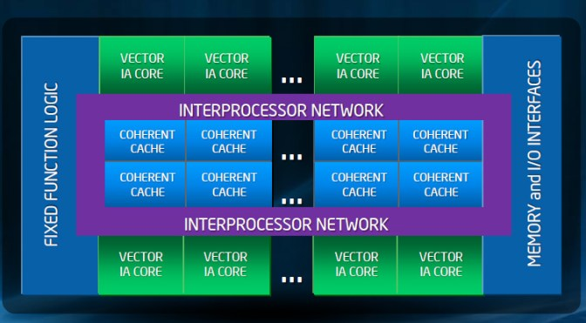
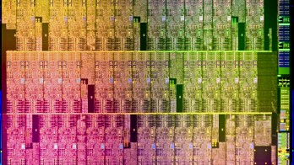
Example: Xeon Phi Ring Bus
Other types of architectures (e.g., NUMA) will be seen later
(distributed systems).
http://www.extremetech.com/extreme/133541-intels-64-core-champion-in-depth-on-xeon-phi
75
Swansea University
Benjamin Mora

Slide 76
MESI protocol
4 states for a cache line (can be encoded with two bits)!
Modified: The cache line inside a CPU core is present but has been modified/written. It differs from what is available in main memory and content is local to cache.
Exclusive: Cache line is only inside current cache, but has not been modified.
Shared: Cache line is present but shared with other caches.
Invalid: Content is invalid.
76
Swansea University
Benjamin Mora

Slide 77
Basic MESI State Diagram
I
S
Bus write
Processor read
Processor
write
Bus read
Bus write
Bus Read
Bus write
E
M
Processor Write
77
Swansea University
Benjamin Mora

Slide 78
MESI protocol
Unchanging transitions not shown in diagram!
Cache lines have a given state.
Processors are listening/snooping the network and can modify their cache line as appropriate.
Enhanced versions do exist!
78
Swansea University
Benjamin Mora

Slide 79
MESI protocol
One scenario: a local-read miss with one non-local cache line in state M (modified.)
Local bus request to read memory.
Snooping cache answers request and put its own copy on the bus
Also change its own copy from M to S (shared.)
And copy its cache line back to memory!
Local processor load and tag the cache line and tag the line as S.
79
Swansea University
Benjamin Mora

Slide 80
Trashing
When data is loaded in cache, some data is likely to be evicted as well!
When large (i.e., > cache size) streams of memory are accessed, cache is not likely to be very useful.
Some specific access patterns can accelerate trashing.
8-way associate caches can only store 8 different lines with same hash code.
Far from the real number of lines (e.g., 1024) available for caching.
80
Swansea University
Benjamin Mora

Slide 81
Trashing
Can happen with:
Micro-op cache: < 200 instructions for Haswell CPUs.
Data Cache.
Pages and TLB caches.
81
Swansea University
Benjamin Mora

Slide 82
Spectre and Meltdown
82
Swansea University
Benjamin Mora

Slide 83
Side Channel Attacks
Spectre and Meltdown “Break” the fundamental concept of memory isolation
Use instruction speculation to read extra memory.
Latency in instruction is used to know whether bits are set to 0 or 1.
Low reading speed (~KBs/S) but valid concept.
83
Swansea University
Benjamin Mora

Slide 84
Side Channel Attacks due to speculative execution
From [1]:
if (x < array1_size)
y = array2[array1[x] * 4096];
Concept: If x is out of range, the then part will never be executed but will be speculated nevertheless. Depending on the cache status, the speculation will take more or less time to run, giving away the (boolean) value of array1[x].
[1] Kocher, Paul, et al. "Spectre attacks: Exploiting speculative execution." arXiv preprint arXiv:1801.01203 (2018).
84
Swansea University
Benjamin Mora

